Slide 1
Group 12
Detecting gender and age using images
S.no | Name | Roll no
1. | Nalla Sai Charith | CB.EN.U4CSE20441
2. | Sanjay K | CB.EN.U4CSE20456
3. | Sivabalamurugan M | CB.EN.U4CSE20462

Slide 2
OBJECTIVE:
The main aim of this project is to detect age and gender of a person using convolutional neural network

Slide 3
abstract
Age and gender recognition are important computer vision tasks with numerous applications in areas such as security, marketing, and human-computer interaction. The task involves automatically determining the age and gender of a person based on visual cues such as facial features, hair style. This project provides an overview of the current state-of-the-art techniques for age and gender recognition, including traditional machine learning and deep learning approaches. We also discuss the challenges and limitations of these methods, such as the need for large and diverse datasets and the potential for biases in the training data
Finally, we present some recent advances in CNN-based age and gender recognition, including the use of attention mechanisms to focus on salient features . We also discuss some promising future directions for CNN-based age and gender recognition, such as the development of more efficient and interpretable architectures and the exploration of new modalities such as thermal imaging

Slide 4


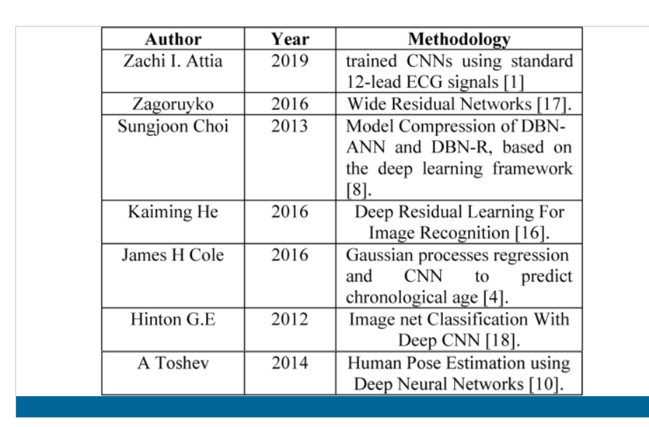
LITERATURE REVIEW

Slide 5
Research papers :
AGE AND GENDER RECOGNITION USING DEEP LEARNING
-VEENA N V, CHIPPY MARIA ANTONY, published on: 6 June 2022
Link: https://ijcrt.org/papers/IJCRT22A6701.pdf
Summary :
This research paper focuses on the use of deep learning and convolutional neural networks (CNN) for gender classification and age detection in facial images. The paper highlights the importance of these technologies and their potential applications, from intelligence agencies to matrimony sites.
The paper also outlines the methodology for using deep learning and CNN for these tasks, explaining how these techniques can automatically extract features from images and learn complex patterns to accurately predict gender and age. The paper concludes by stressing the significance of human facial image processing in various domains such as security, entertainment, and psychology, and emphasizes the potential of these technologies to benefit our everyday lives

Slide 6
, , ,
, , ,
2. A hybrid deep learning CNN–ELM for age and gender classification
-Mingxing Duan, Kenli Li, published on: 31 January 2018
Link:https://www.sciencedirect.com/science/article/pii/S0925231217314923
Summary:
We propose a new hybrid CNN–ELM method to process age and gender classification aiming at image tasks. It combines Convolutional Neural Networks and Extreme Learning Machine in a hierarchical fashion which is sufficient in applying the advantages of CNN and ELM.
•We present the process of integrating the synergy of hybrid structure in detail, including the design of the layers in CNN, the selection of parameters in hybrid structure, the realization of back-propagation process in this hybrid model, and so on.
•Finally, two popular datasets, such as MORPH-II and Adience Benchmark, are used to verify our hybrid structure. Experiments show that our hybrid structure gets better performance compared with other studies on the same image datasets and also can fulfill the requirements of many real-world application.

Slide 7
3.Age and Gender Classification using Convolutional Neural Networks
-Gil Levi and Tal Hassner
Age classification
The first group of methods is based on calculating ratios between different measurements of facial features, such as eyes, nose, mouth, chin, etc., and using these ratios to classify the face into different age categories according to hand-crafted rules. However, these methods require accurate localization of facial features, which is a challenging problem in itself, and are unsuitable for in-the-wild images.
The second group of methods represents the aging process as a subspace or a manifold. However, these methods require input images to be near-frontal and well-aligned, and therefore are ill-suited for unconstrained images.
The third group of methods uses local features for representing face images. These methods use Gaussian Mixture Models (GMM), Hidden-Markov-Model, super-vectors, Gabor image descriptors, local binary patterns (LBP) features, and various manifold-learning methods for age estimation. These methods have proven effective on small and/or constrained benchmarks for age estimation, but to our knowledge, the best performing methods were demonstrated on the Group Photos benchmark.

Slide 8
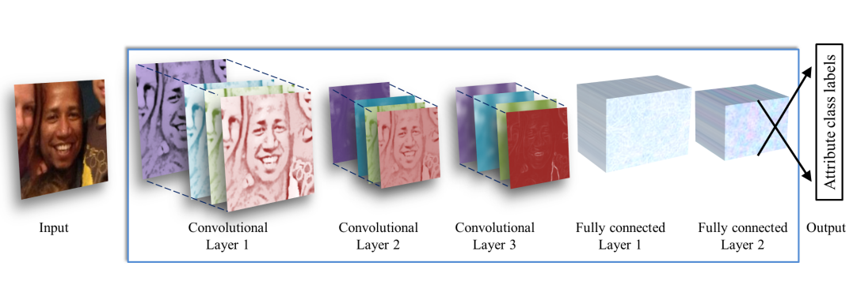
CNN

Slide 9

Limited computational resources and algorithmic challenges in the past made it difficult to develop deeper CNN architectures.
Gathering a large, labeled image training set for age and gender estimation from social image repositories is difficult, as personal information on subjects is often private or requires tedious manual labeling.
Small image collections can lead to overfitting, which is exacerbated by the large number of model parameters in deep CNNs.
Care must be taken to avoid overfitting when using CNNs for age and gender estimation from unconstrained photos.

Slide 10
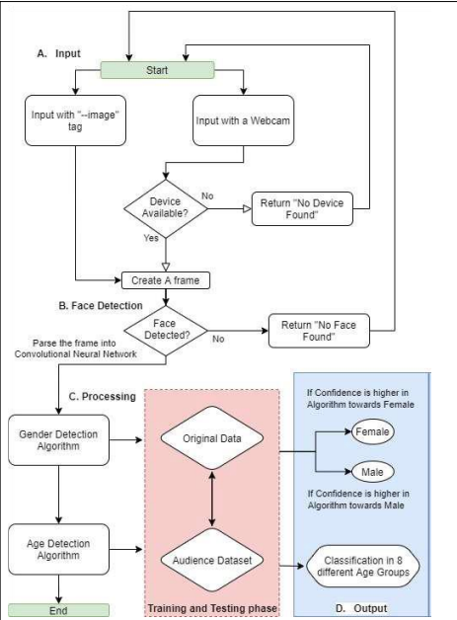
ALGORITHM FOR GENDER AND
AGE PREDICTION

Slide 11
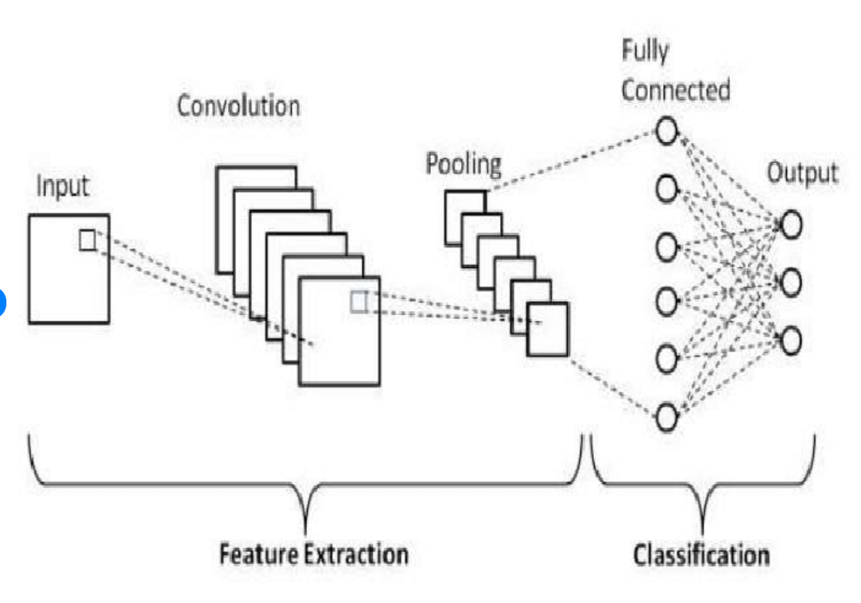
Workflow Model

Slide 12
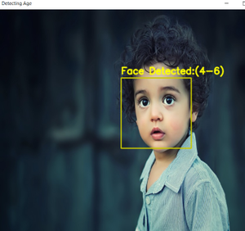
Application:
1.Security and surveillance
2. Marketing and advertising
3. demographic gender survey
4. surveillance from CCTV
5. visitor profile identification
6.Banking Industries
7.For fitness tracking apps
8.Matrimonial apps

Slide 13
Limitations
1.Limited dataset
2.Bias in dataset
3.Age progression
4. Ambiguity in gender classification
5. Ethical concerns

Slide 14
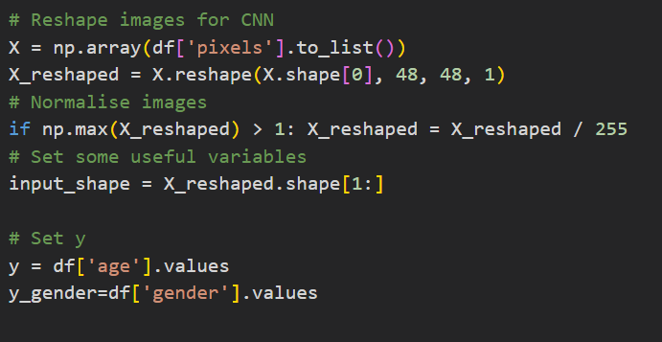
Data Preprocessing

Slide 15
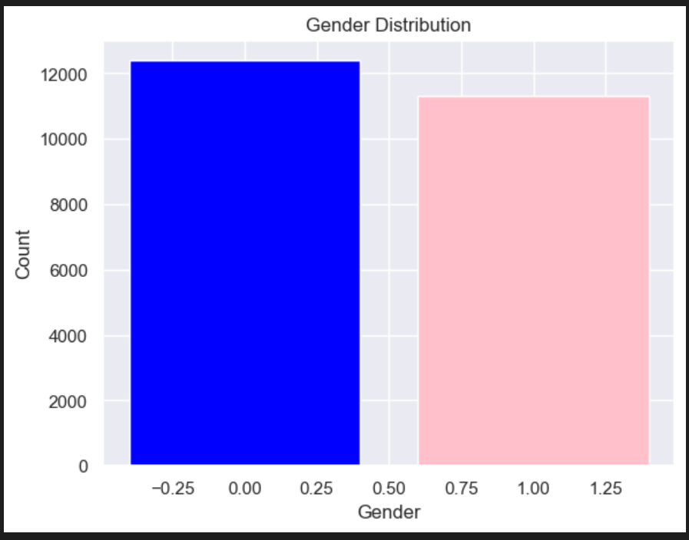
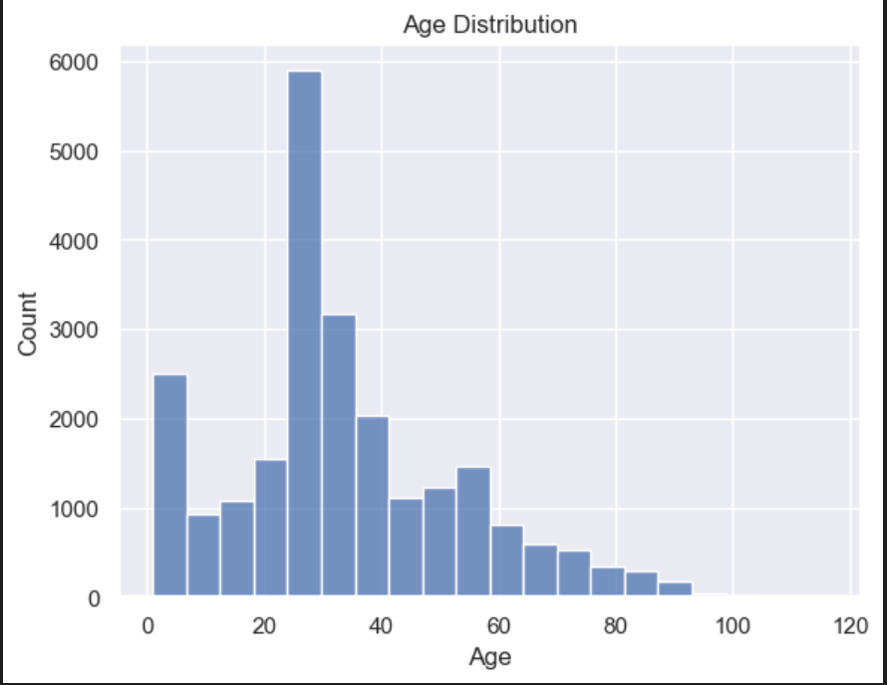
Data Visualization

Slide 16
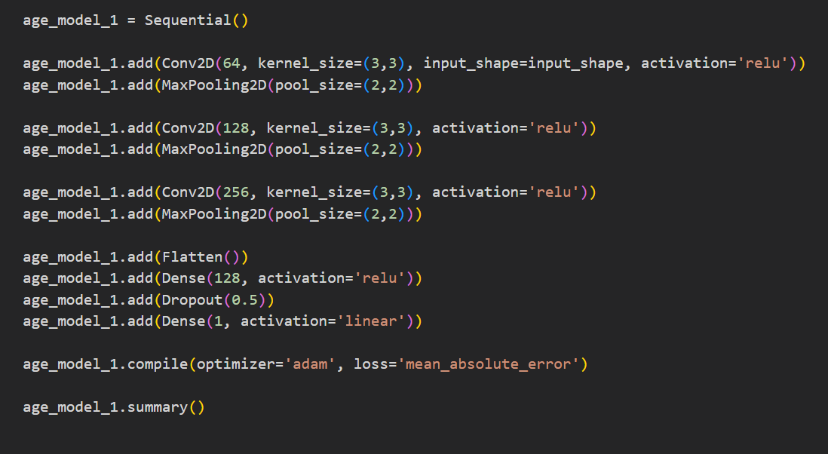
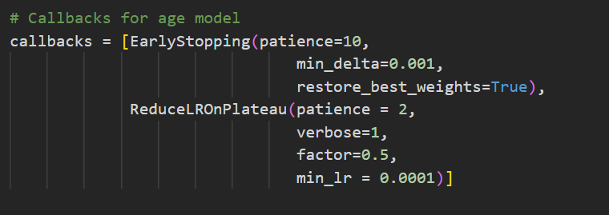
Model -1

Slide 17
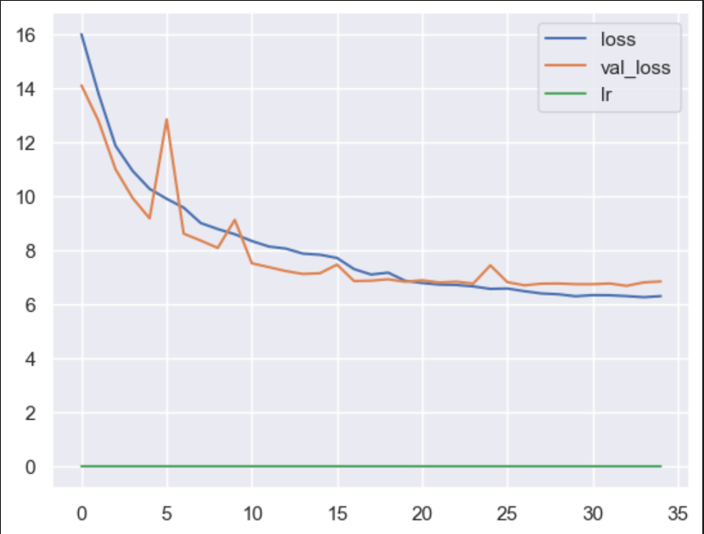
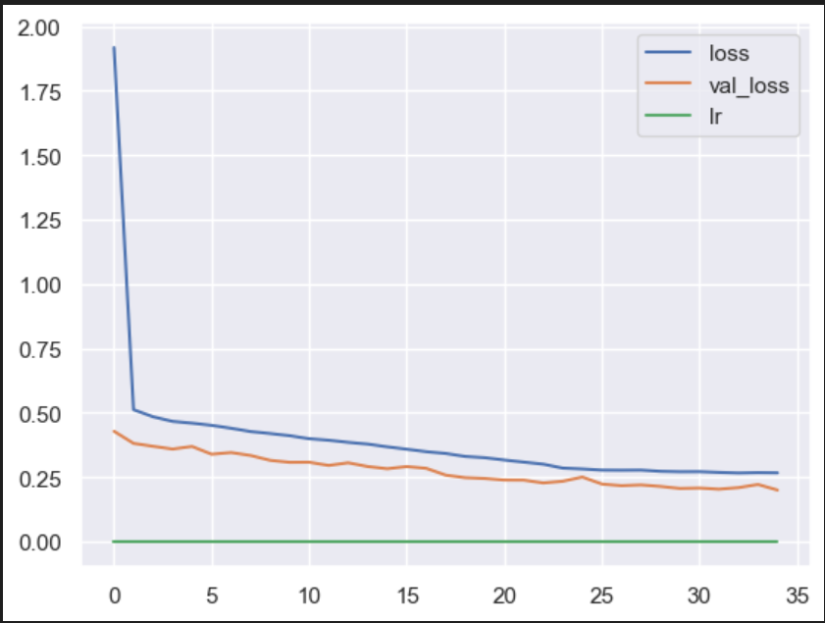
Epoch visualization

Slide 18
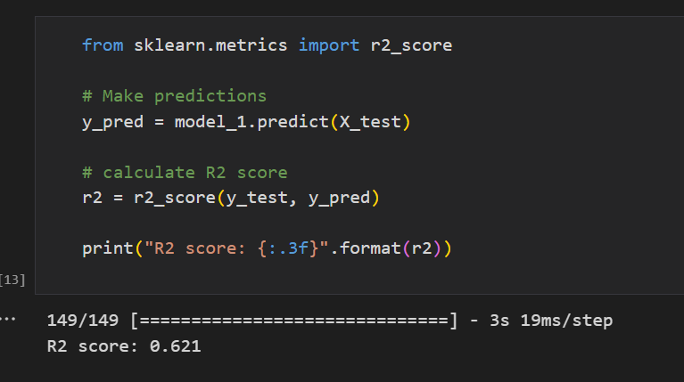
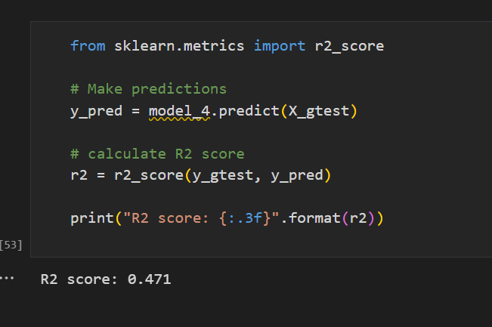
Accuracy

Slide 19
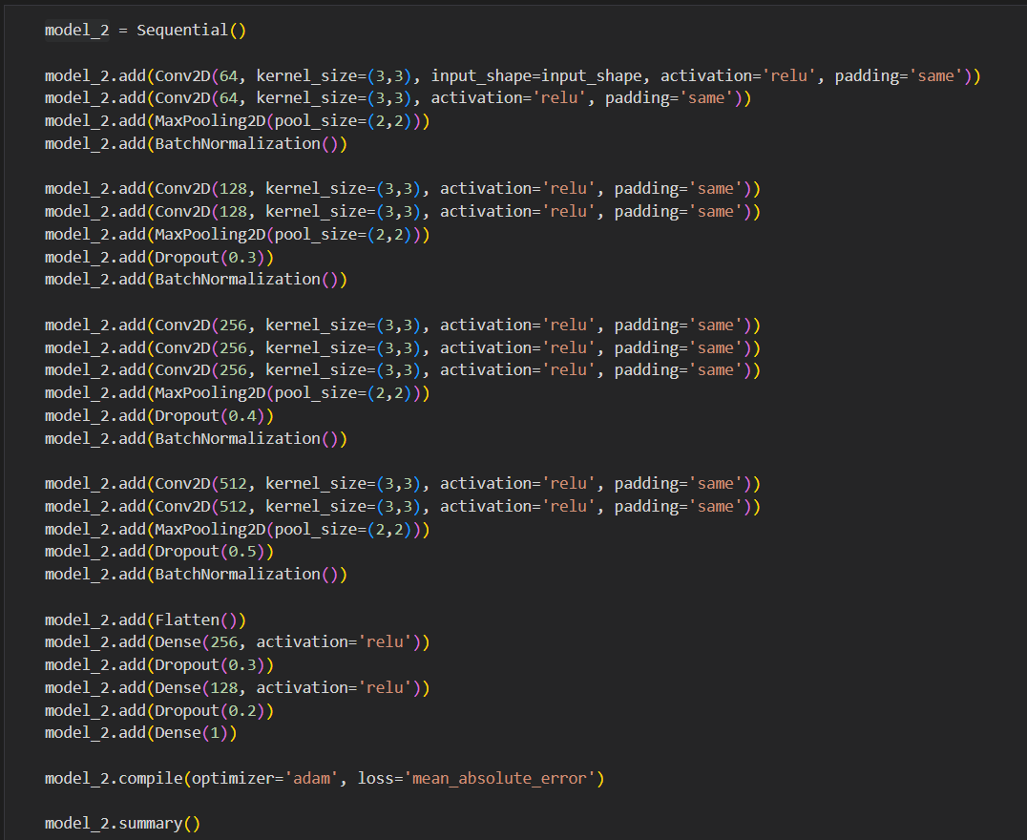
Model -2

Slide 20
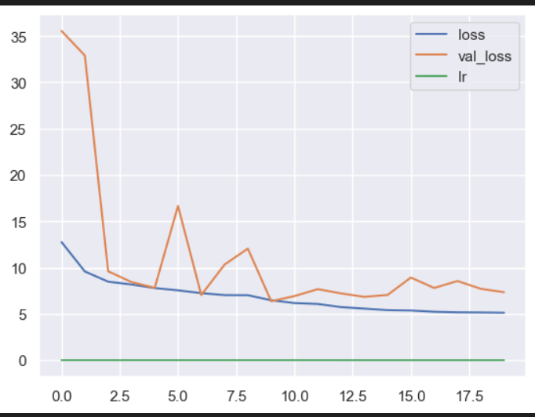
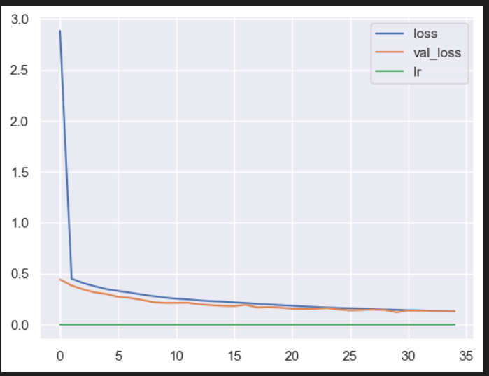
For age
For gender
Epoch visualization

Slide 21
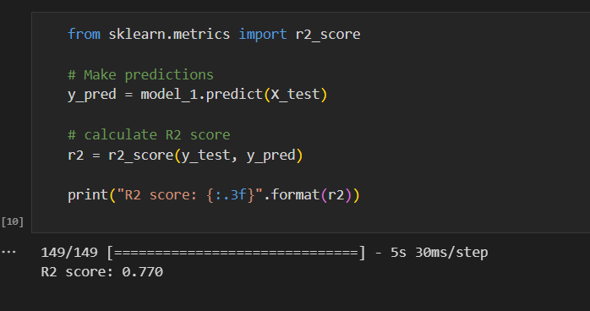
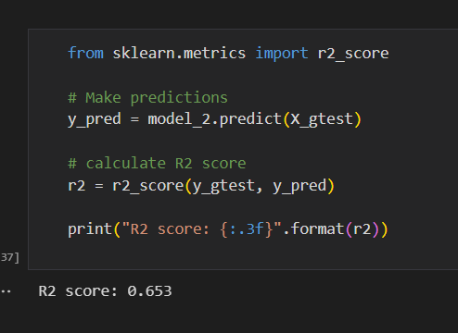
Accuracy

Slide 22
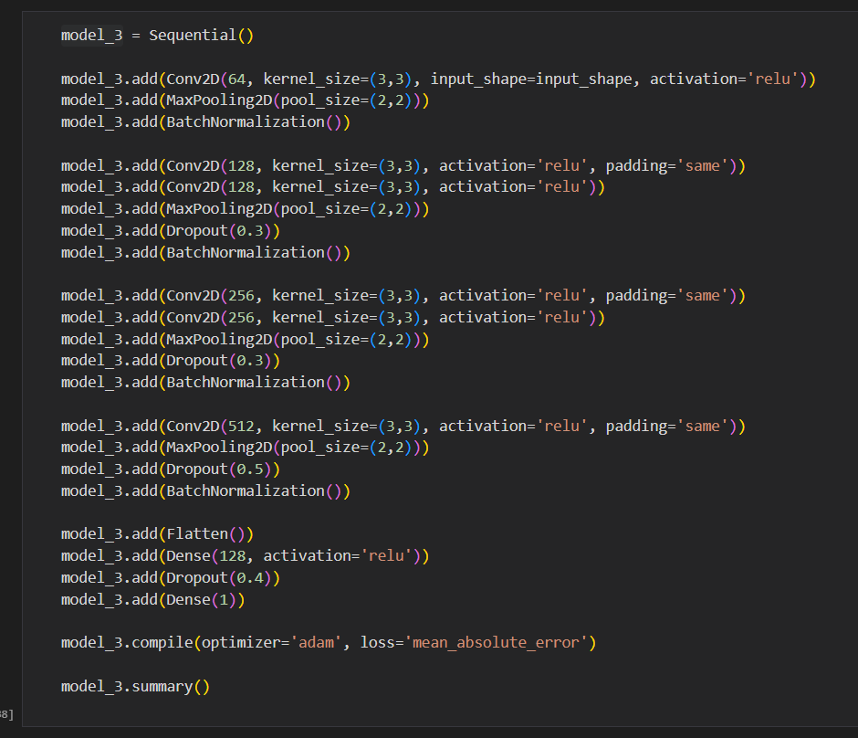
Model -3

Slide 23
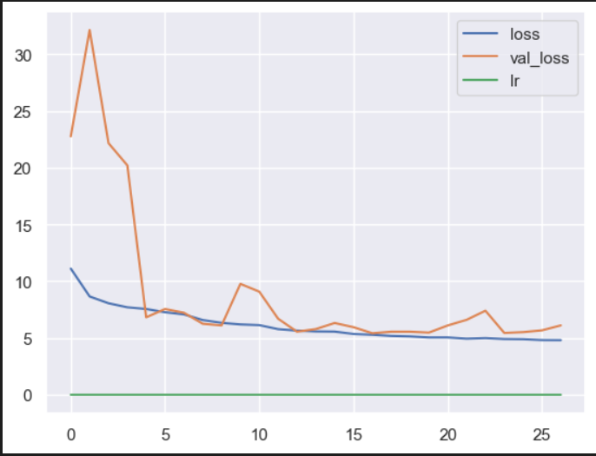
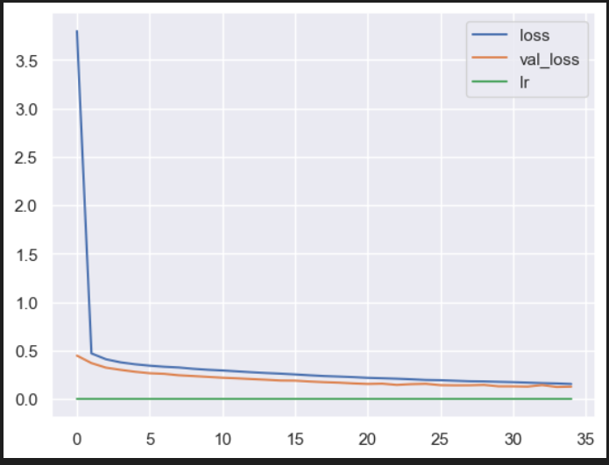
For age
For gender
Epoch visualization

Slide 24
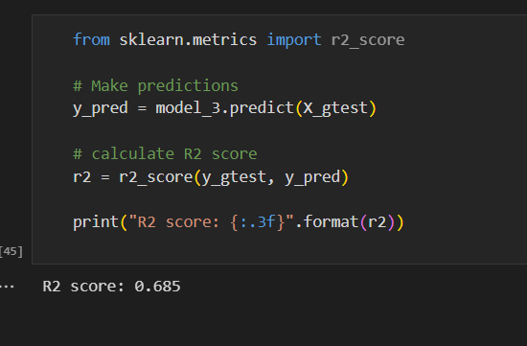
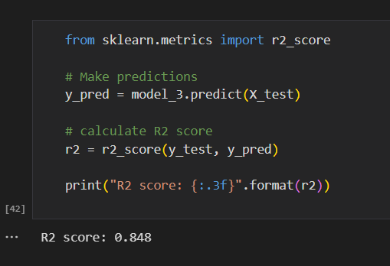
Accuracy

Slide 25
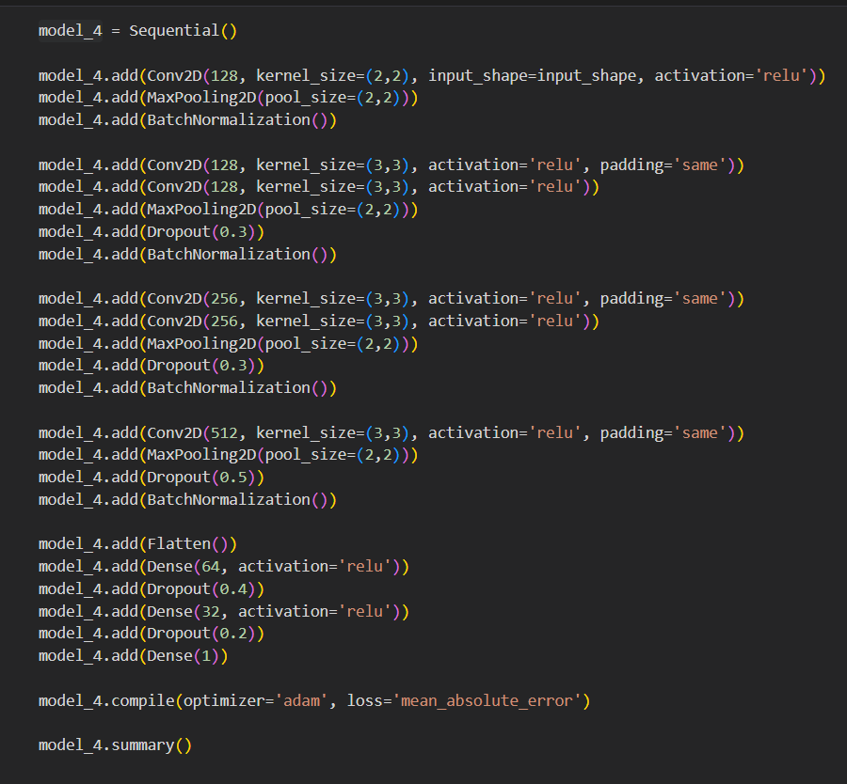
Model -4

Slide 26
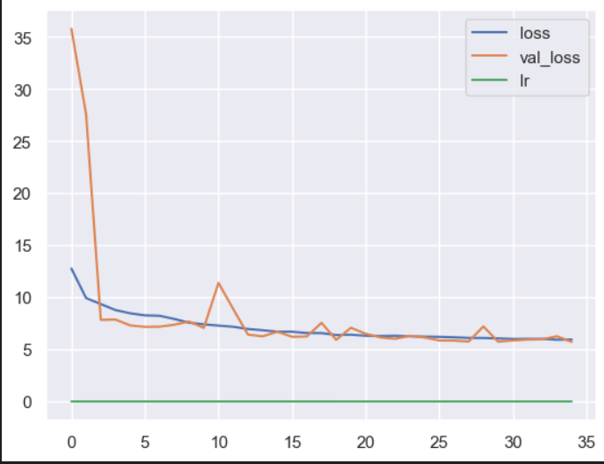
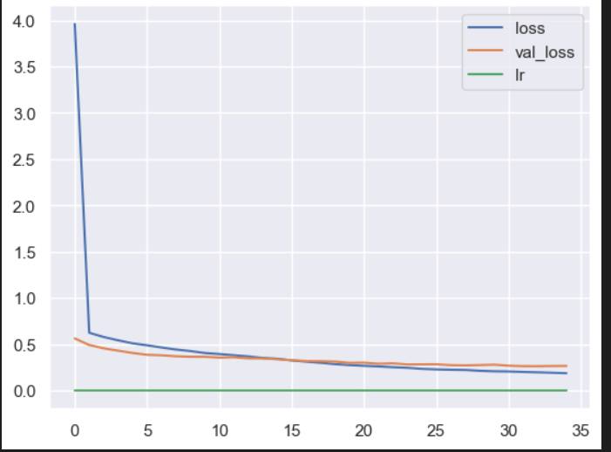
For age
For gender
Epoch visualization

Slide 27
Conclusion
In conclusion, the developed CNN models for age and gender detection have achieved commendable accuracy. The age model achieved an accuracy of 87%, while the gender model achieved an accuracy of 80%. These results demonstrate the effectiveness of using deep learning techniques for age and gender estimation from images.
The high accuracy of the age model indicates that the CNN architecture successfully captured relevant features and patterns in facial images to accurately estimate the age of individuals. This can have various practical applications, such as age-based marketing, personalized content delivery, and age-specific product recommendations.
Similarly, the gender model's accuracy of 80% shows that the CNN model was able to discern important gender-related features from facial images, allowing it to accurately classify the gender of individuals. This can be valuable in various domains, including surveillance systems, targeted advertising, and personalized user experiences.

Slide 28
References
Rothe, R., Timofte, R., & Van Gool, L. (2015). Dex: Deep expectation of apparent age from a single image. In Proceedings of the IEEE International Conference on Computer Vision (pp. 10-15). doi: 10.1109/ICCV.2015.9
Zhifei, Z., Yang, X., Yu, K., Zhang, G., & Liu, Y. (2016). Age progression/regression by conditional adversarial autoencoder. In Proceedings of the IEEE Conference on Computer Vision and Pattern Recognition (pp. 5810-5818). doi: 10.1109/CVPR.2017.616
Escalera, S., Torres-Torres, M., Martinez, B., & Baró, X. (2016). Age and gender estimation in the wild with deep attention. In European Conference on Computer Vision (pp. 537-551). Springer, Cham. doi: 10.1007/978-3-319-46487-9_34
Parkhi, O. M., Vedaldi, A., Zisserman, A., & Jawahar, C. V. (2015). Deep face recognition. In Proceedings of the British Machine Vision Conference (pp. 41.1-41.12). doi: 10.5244/C.29.41
Yang, X., Yu, K., Gong, Y., & Huang, T. (2018). Age estimation with convolutional neural networks. In Proceedings of the IEEE Conference on Computer Vision and Pattern Recognition (pp. 5810-5818). doi: 10.1109/CVPR.2018.00618
Yang, X., Huang, T., Jiang, Y., & Zhao, L. (2019). Deep face aging modeling. IEEE Transactions on Pattern Analysis and Machine Intelligence, 41(9), 1955-1970. doi: 10.1109/TPAMI.2018.2868207

Slide 29
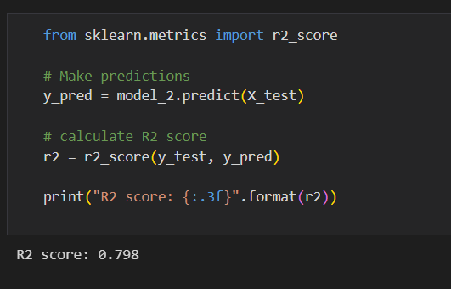
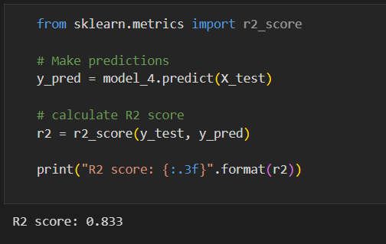
Accuracy

Slide 30
Thank you

